Slide 1




TEAM SHADOW
DESCRIPTION
BUILDER
PRESENTED BY:
ABHIJAY S
SUNIL KUMAR

Slide 2

PROBLEM STATEMENT
Description: Build algorithms to automate text generation for the kitchen type based
on the menus that kitchen offers. The summary should be 2-3 lines in the mobile screen width.
For instance:
• This home chef specializes purely Punjabi dishes specifically country / villagestyle dishes. Generally, these dishes are made with organic ingredients.
• This kitchen brings the best out of Keralite food, very authentic and delicious
specials.
• Prema is passionate about making delicacies of Italian food and enjoys cooking
unique culinary specials of Italy.

Slide 3



OBJECTIVES
Fine-tuning T5 Model
Data Processing and Tokenization:
Optimize Training Configuration:
Specialize a pre-trained T5 model for generating kitchen descriptions by adjusting its parameters.
Prepare kitchen description and menu item data for training and tokenize it using the T5 tokenizer.
Configure training parameters to efficiently train the model for accurate kitchen description generation.

Slide 4


UNIQUE FEATURES
Custom Dataset Handling:
This feature facilitates easy integration of diverse datasets into machine learning pipelines. For instance, it can automate the generation of product descriptions in e-commerce, ensuring efficient utilization of data.
Fine-tuning Pre-trained Models:
By fine-tuning pre-trained models, users can leverage existing knowledge for specific tasks, especially in scenarios with limited labeled data. This approach is valuable for automating tasks like medical report generation in healthcare.
Training Configuration Optimization:
Optimization of training parameters maximizes model performance while managing computational costs effectively. This is crucial, particularly in tasks such as sentiment analysis of customer feedback in financial services, ensuring timely and cost-effective analysis.

Slide 5

ALGORITHM
Data Preprocessing
- Read data from a CSV file containing kitchen descriptions and menu items.
- Concatenate kitchen descriptions and menu items into a single text.
Tokenization:
- Tokenize the concatenated text using the `Tokenizer` class from Keras.
- Convert the text into sequences of tokens.
- Generate input sequences for training.
Model Training (Keras):
- Build and train a sequential neural network model (`model1`) using Keras.
- Add an embedding layer followed by two LSTM layers and a dense layer with softmax activation for text generation.
- Compile the model with the sparse categorical cross-entropy loss function and the Adam optimizer.
- Train the model on input sequences and labels for 10 epochs.
4.Model Saving (PyTorch):
Save the trained Keras model (model1) using PyTorch's torch.save() function.
5.Training Another Model (Keras):
Build and train another sequential neural network model (model) using Keras.
This model has a similar architecture to model1 but with different dimensions and parameters.
Compile and train the model using the same configuration as model1.

Slide 6

ALGORITHM
7.Loading Models and Tokenizer:
Load the saved PyTorch model and the Keras tokenizer back into memory.
8.Text Generation:
Define a function generate_description() to generate text descriptions based on the trained model and tokenizer.
The function takes a menu as input and generates a text description for it using the trained model.
9.Interacting with LangChain:
Set up an environment variable for the OpenAI API key.
Interact with LangChain by passing the generated description to an instance of the OpenAI class, which uses OpenAI's GPT-3 model to generate a meaningful sentence based on the given description.
10.Output:
Print the generated description.
Print the output generated by LangChain, which is a meaningful sentence based on the generated description.

Slide 7

FEATURES
Utilization of Pre-trained Models: It leverages pre-trained T5 models, saving time and resources required for training from scratch while benefiting from the extensive pre-training on large text corpora.
Customization for Specific Tasks: The program allows fine-tuning of the T5 model for the specific task of generating kitchen descriptions, enhancing its performance and adaptability to the task at hand.
Efficient Data Handling: With the custom dataset class, the program efficiently handles data preprocessing and tokenization, ensuring compatibility with the model and simplifying the integration of diverse datasets.

Slide 8
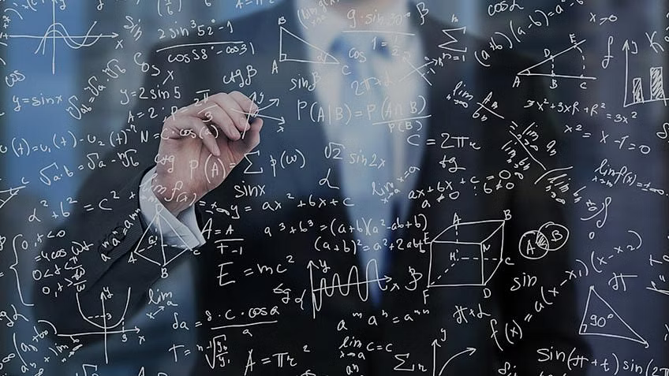
FEATURES
Optimized Training Configuration: Users can easily configure training parameters, such as batch size and number of epochs, optimizing model training for accuracy and efficiency.
Real-world Application: The program's capability to generate kitchen descriptions has practical applications in various domains, including e-commerce for automating product descriptions or in hospitality for menu creation and restaurant promotion.
Scalability: The modular design of the program allows for scalability, enabling adaptation to larger datasets or different tasks with minimal modifications.
Resource Efficiency: By utilizing pre-trained models and optimizing training configurations, the program ensures efficient use of computational resources, reducing training time and costs.

Slide 9
FUTURE IMPROVEMENNTS
Data Augmentation: Introduce techniques to diversify training data, enhancing model adaptability.
Transfer Learning: Utilize pre-trained models from related tasks for improved performance.
Regularization: Apply techniques like dropout to prevent overfitting and improve generalization.
Model Interpretability: Investigate methods for understanding model decisions, enhancing transparency.
Deployment Optimization: Optimize model efficiency and scalability for production environments.

Slide 10
TEAM SHADOW
THANK YOU

